Slide 1
ImpEx
Module - 7

Slide 2
Contents
Overview
Syntax and Examples
Invoking

Slide 3
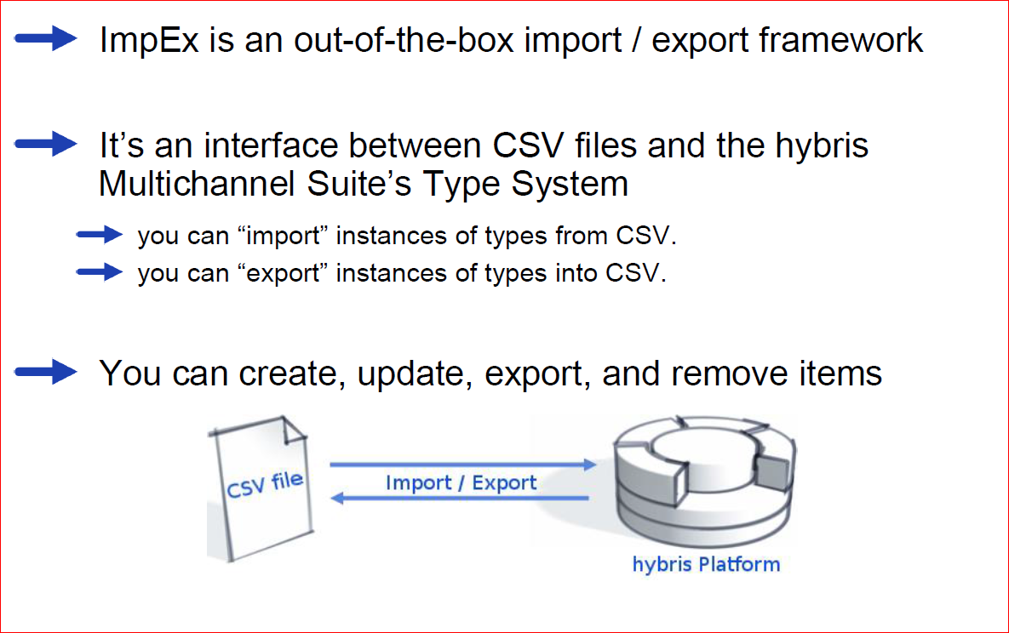
ImpEx – Overview

Slide 4
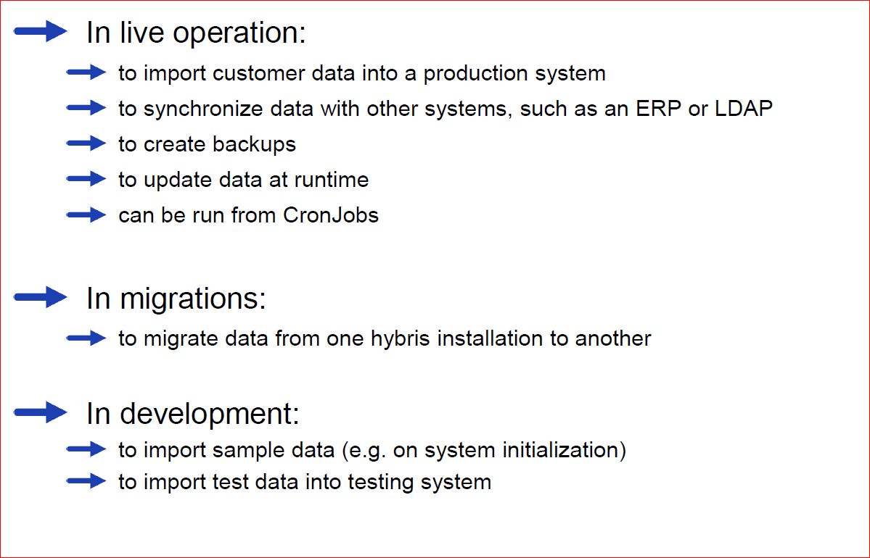
ImpEx – Typical fields of use

Slide 5
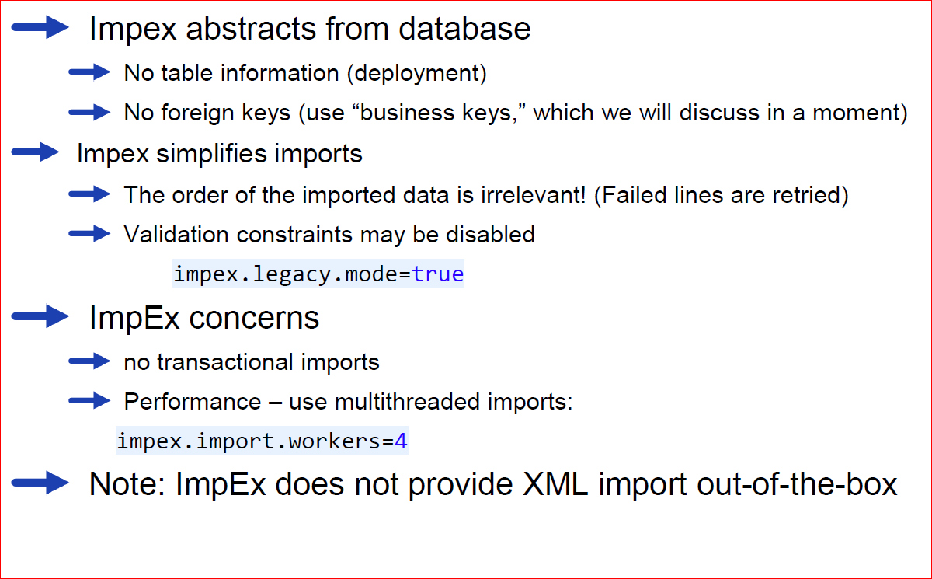
ImpEx – Features

Slide 6
Contents
Overview
Syntax and Examples
Invoking

Slide 7
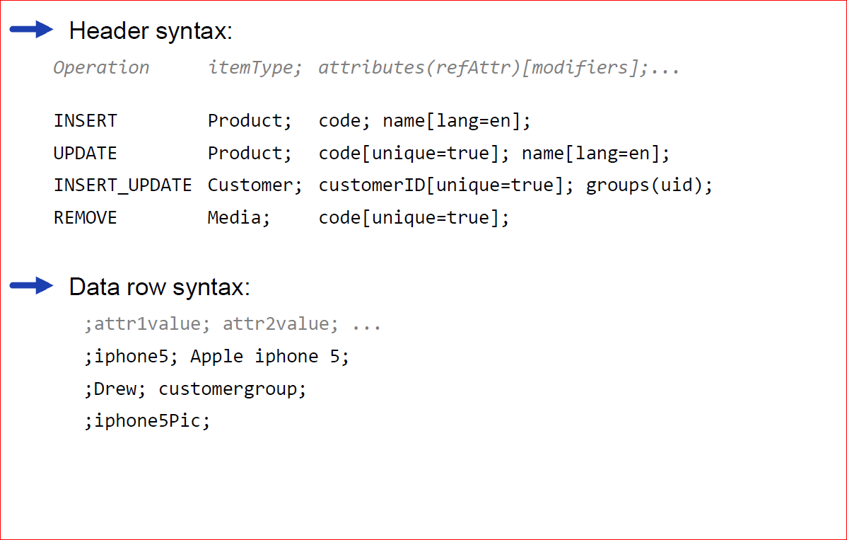
Syntax Basics

Slide 8
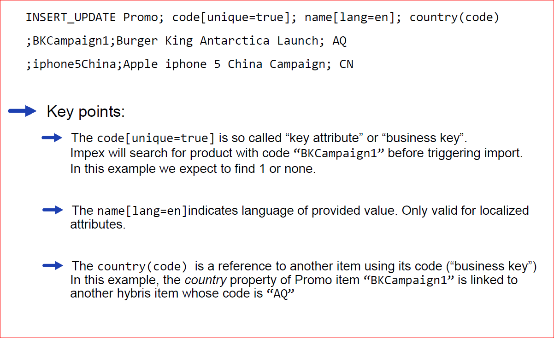
Basic syntax example

Slide 9
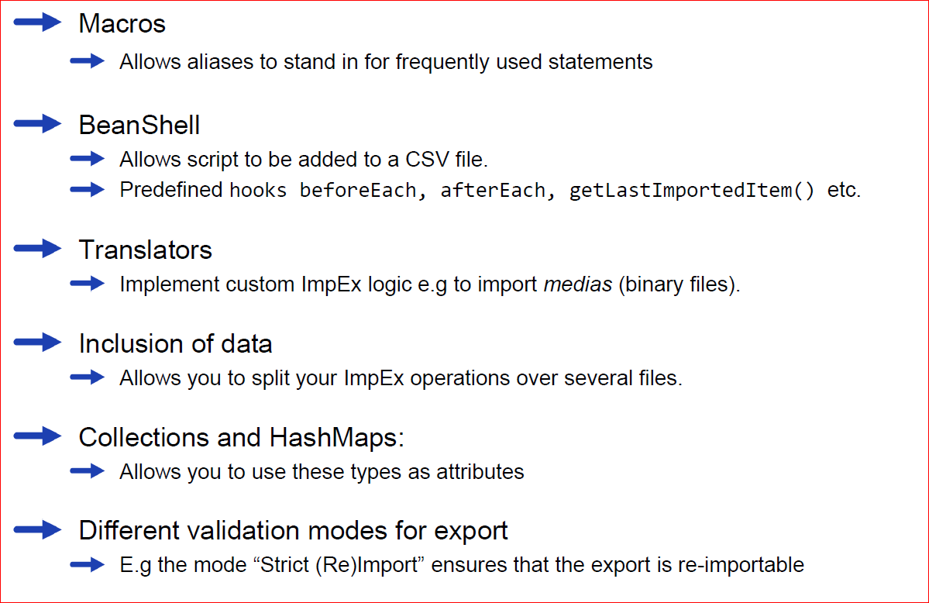
ImpEx Syntax Elements

Slide 10
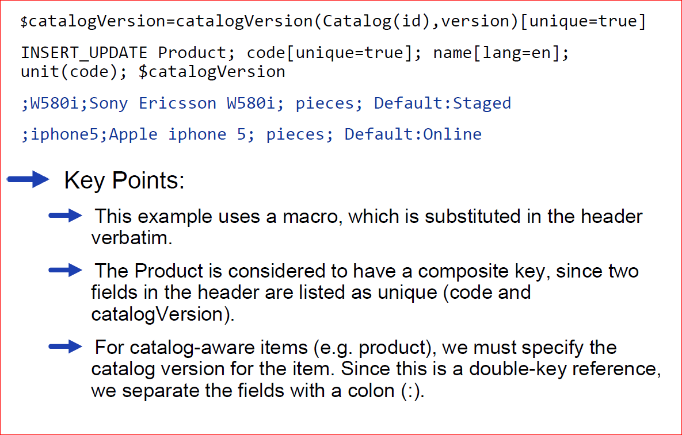
Catalog example

Slide 11
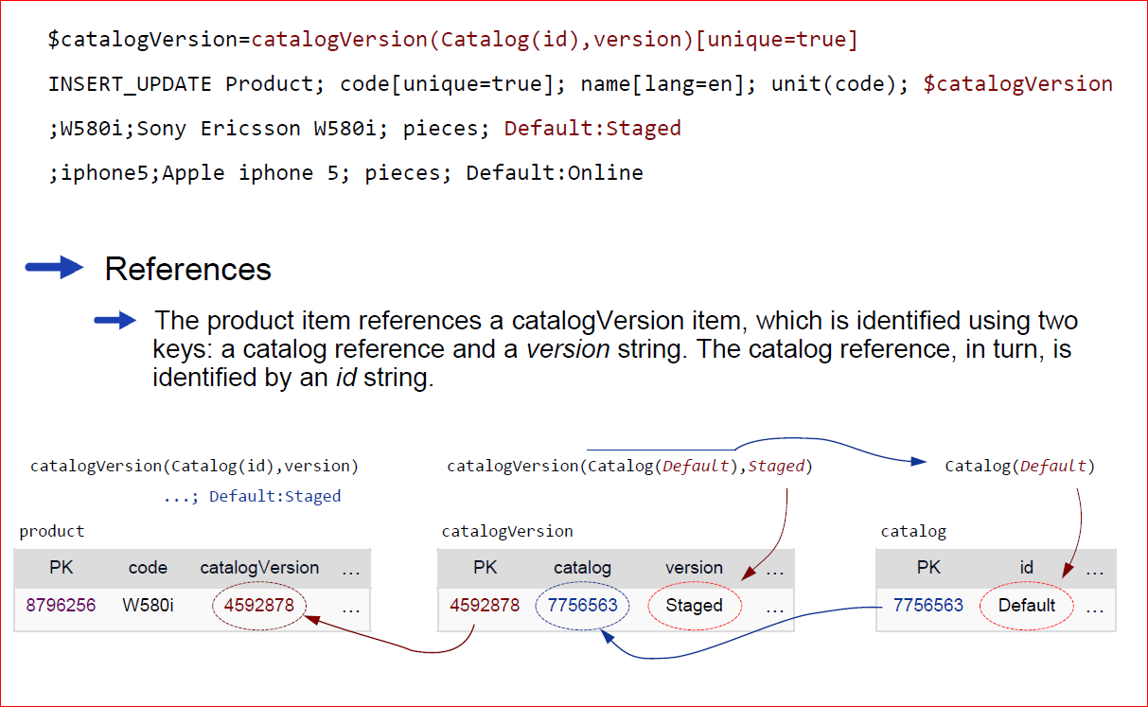
Catalog reference details

Slide 12
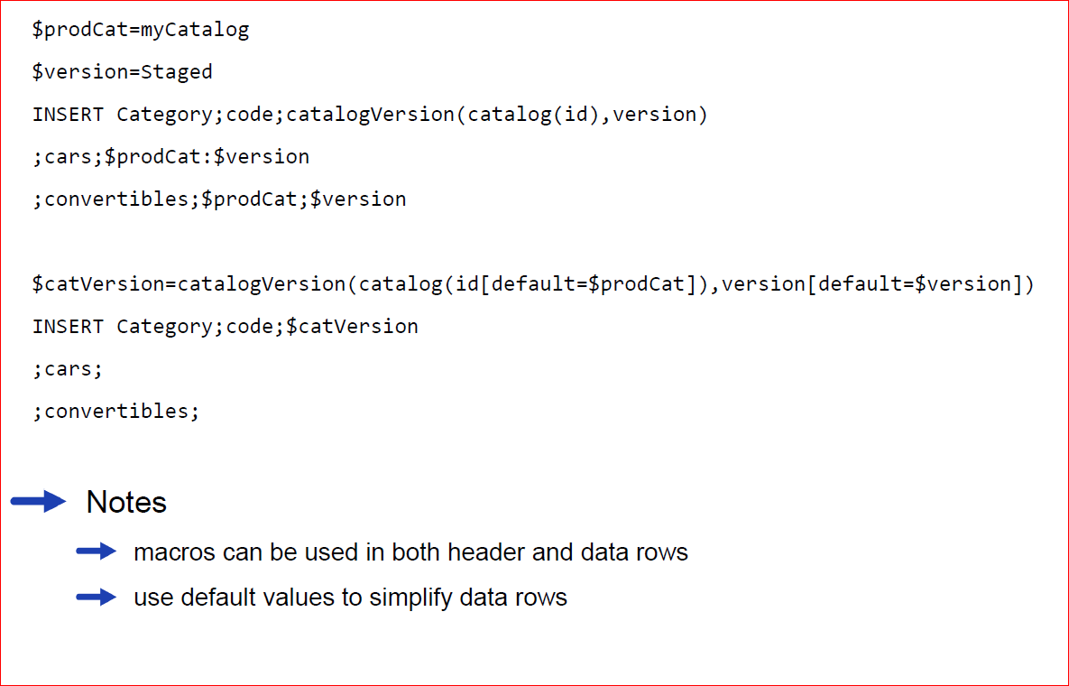
Using macros and defaults

Slide 13
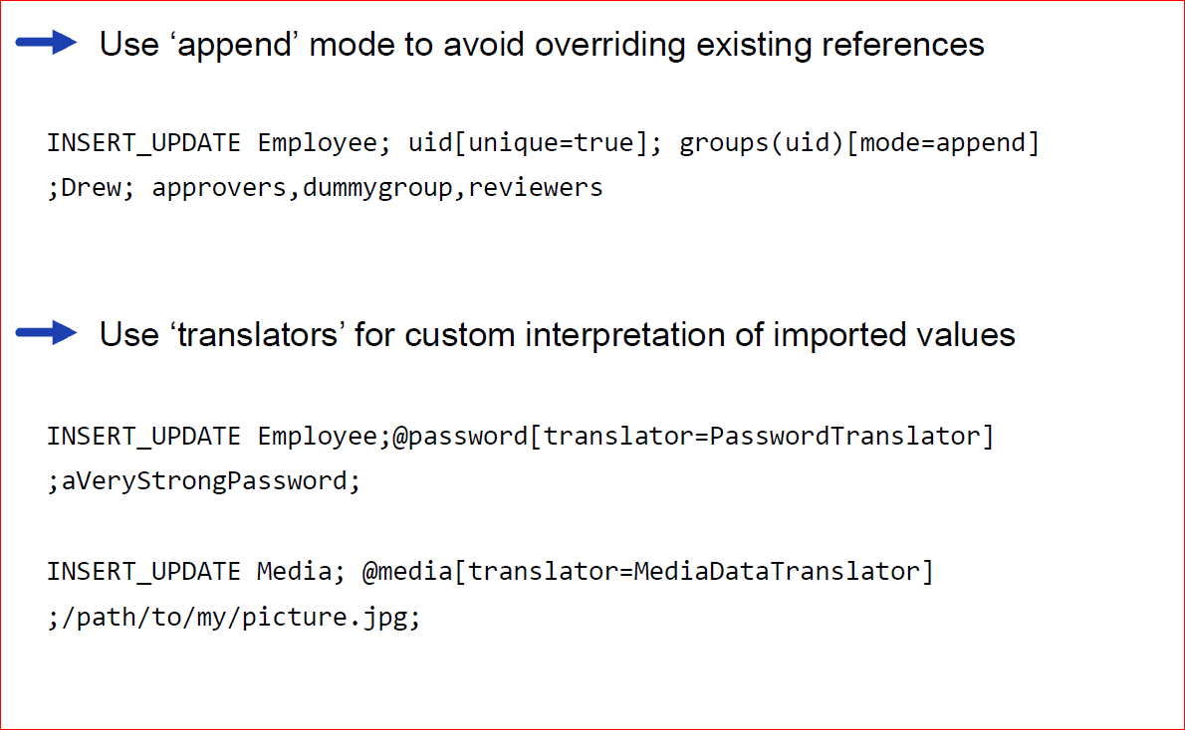
More examples

Slide 14
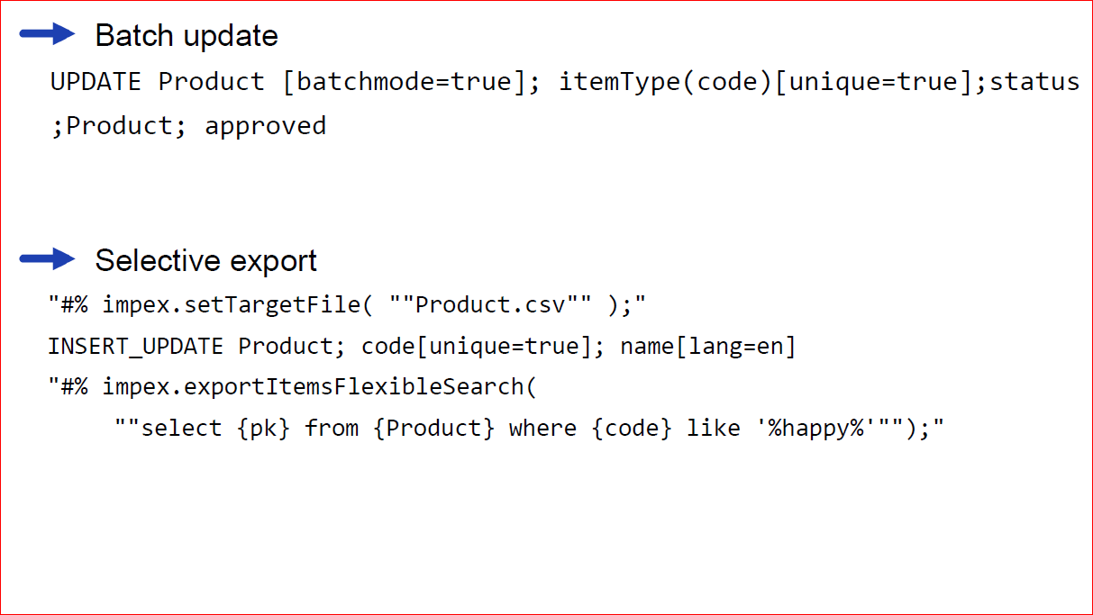
Advanced example

Slide 15
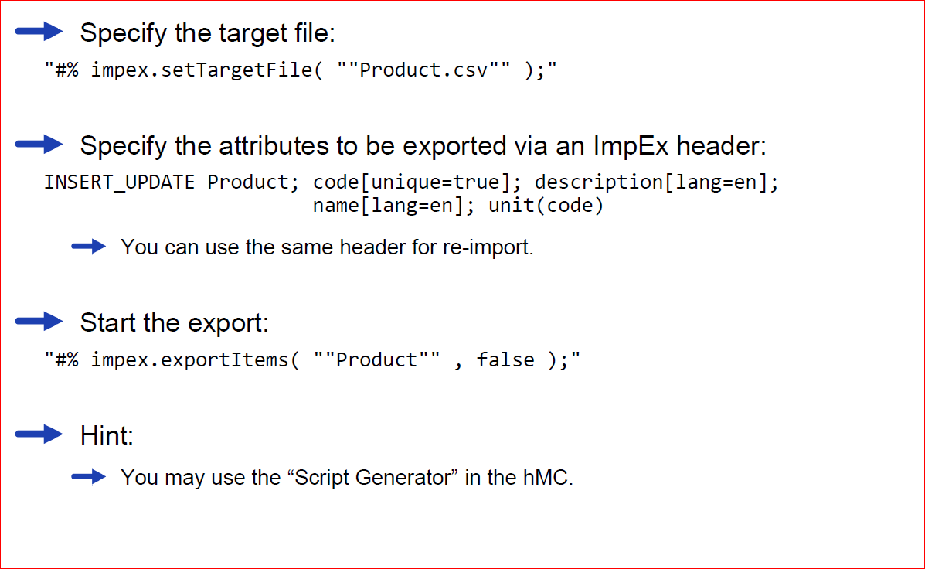
ImpEx Script For Export

Slide 16
Contents
Overview
Syntax and Examples
Invoking

Slide 17
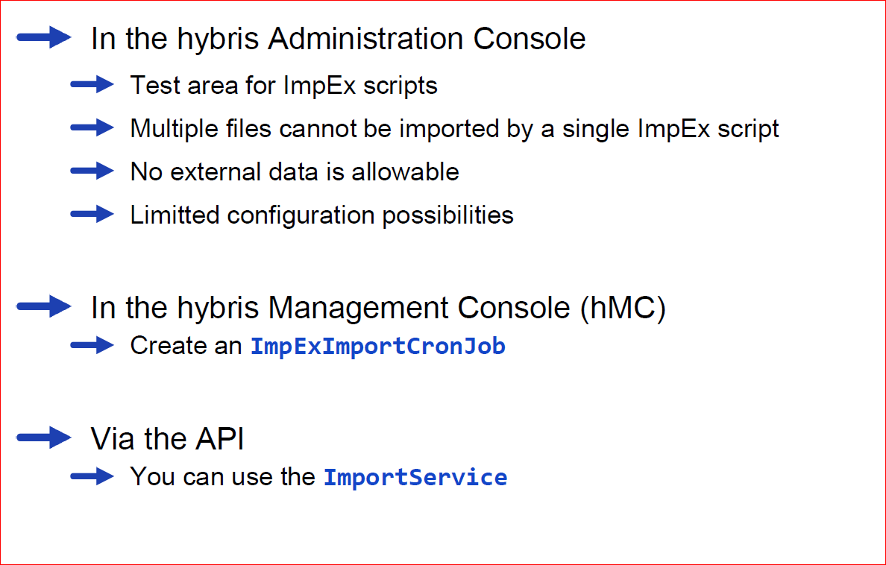
Where Can You Launch an Import?

Slide 18
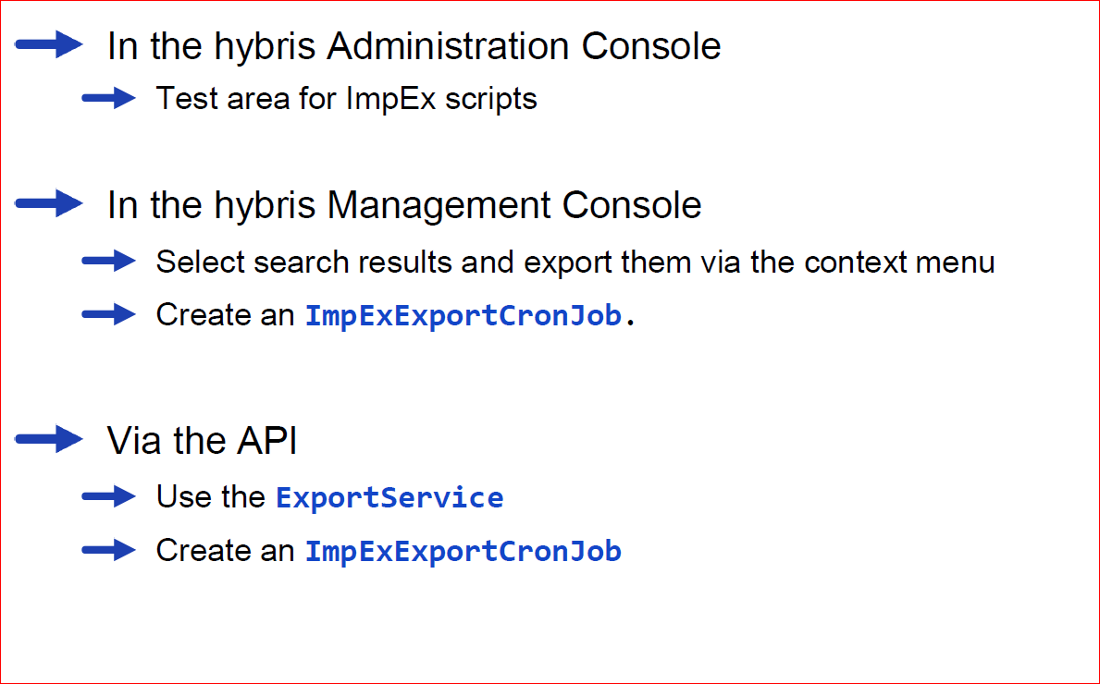
Where Can You Launch an Export?

Slide 19
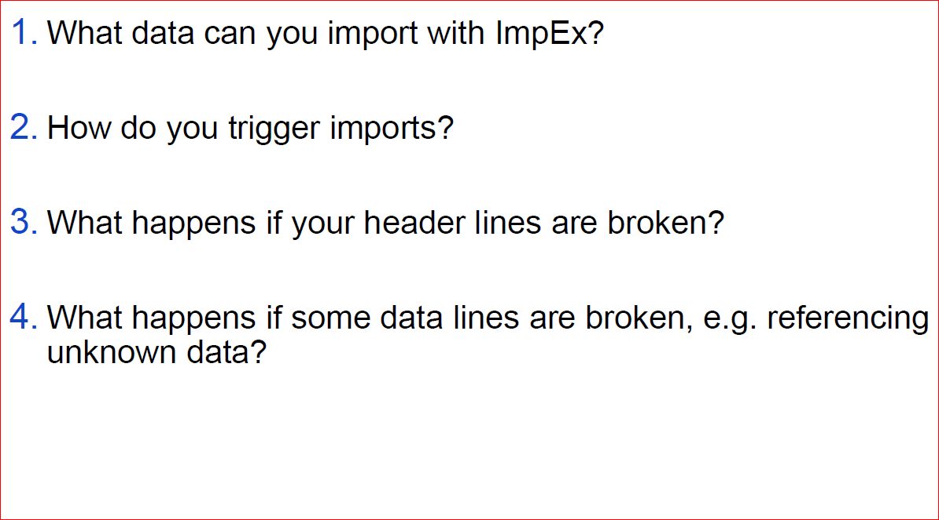
Quizzies

